Slide 1
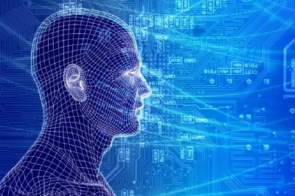
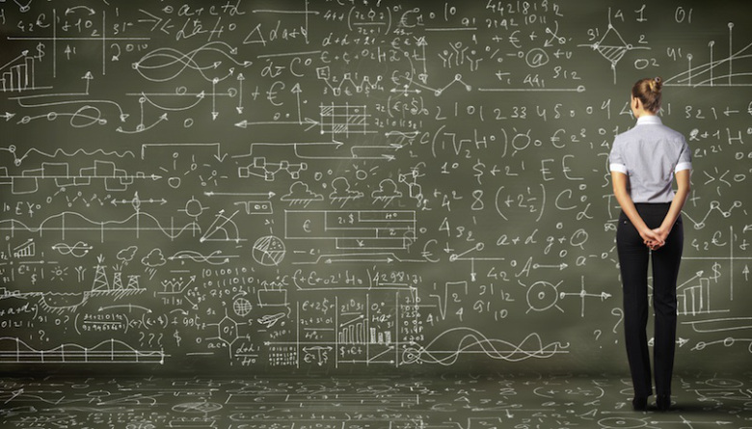
Applying Recent Advances in Machine Learning to Networking
David Meyer
Brocade Chief Scientist and Fellow
dmm@{brocade.com,uoregon.edu,1-4-5.net,..}
http://www.1-4-5.net/~dmm/ml/talks/2016/ngp_forum.{pptx,pdf}
NGP Forum/SDN & Openflow World Congress
10-14 October 2016
The Hague, Netherlands

Slide 2
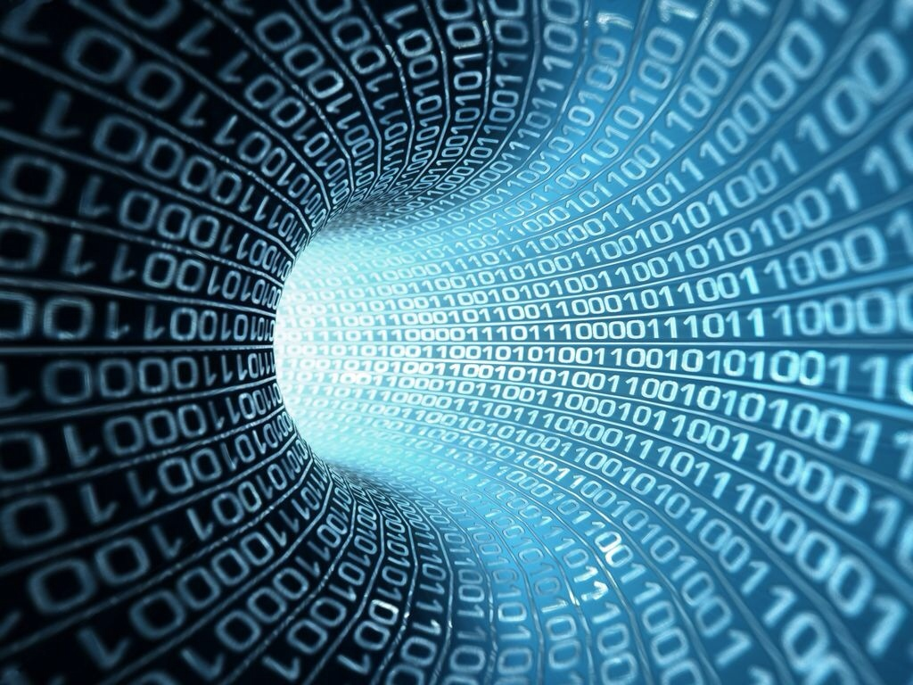
You might be surprised but what is going to drive innovation in the enterprise and in the public cloud is machine learning.
Bill Coughran, Sequoia Capital #‎ONUGSpring16‬

Slide 3
Machine Learning is the way we are going to automate your automation.
Chris Wright, RedHat CTO #RHSummit

Slide 4
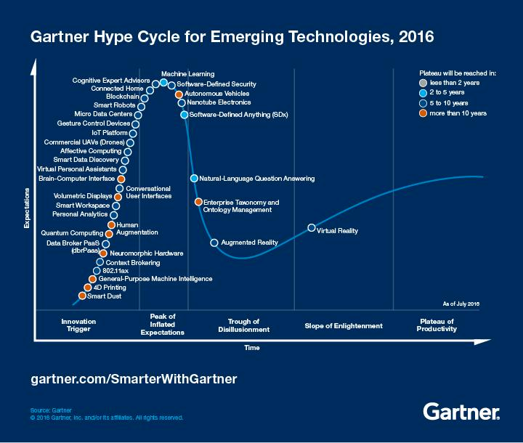
Whatever Machine Learning Is…
You are here (again)

Slide 5
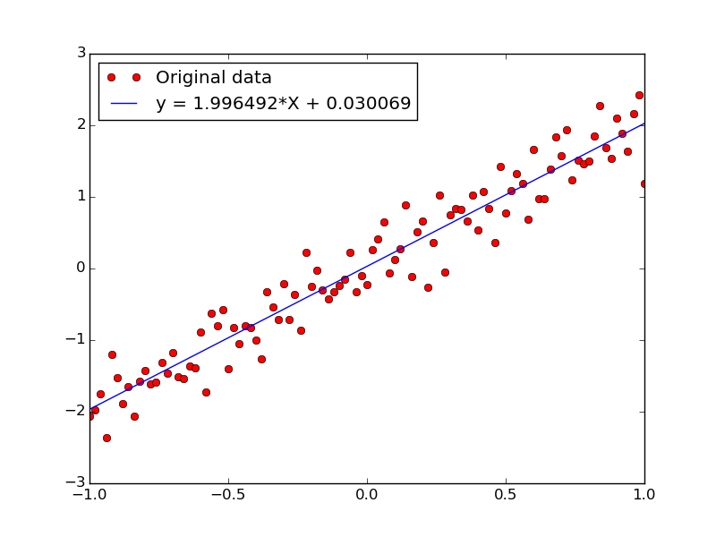
Agenda
What Is Machine Learning?
Why All The (Machine Learning) Excitement?
Combining SDN and Machine Learning
What’s On the Horizon?
Technical explanations/code
https://github.com/davidmeyer/ml
http://www.1-4-5.net/~dmm/ml

Slide 6
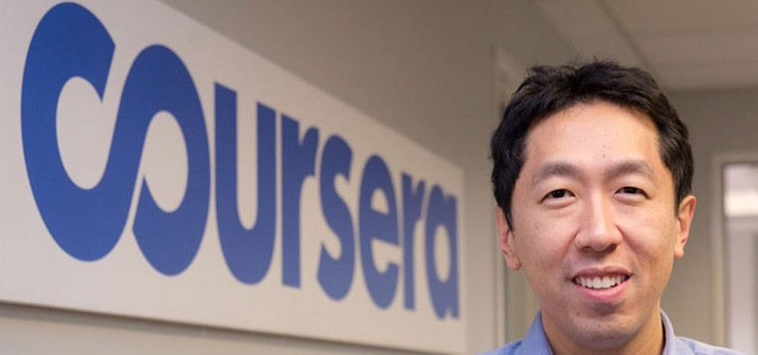
What Is Machine Learning?
The complexity in traditional computer programming is in the code (programs that people write). In machine learning, learning algorithms are in principle simple and the complexity (structure) is in the data. Is there a way that we can automatically learn that structure? That is what is at the heart of machine learning.
-- Andrew Ng
Said another way, we want to discover the Data Generating Distribution that underlies the data that we observe. This is the function that we want to learn.
Moreover, we care about primarily about the generalization accuracy of our model (function)
Accuracy on examples we have not yet seen (BTW, how is this possible?)
as opposed the accuracy on the training set (note: overfitting)

Slide 7
Same Thing Said In Cartoon Form
(Three main types of Machine Learning)
Traditional Programming
Data
Computer
Output
Program
Machine Learning
Data
Computer
Program
Environment
Output
Supervised Learning: training set of the form {(x_{i},y_{i})}; y_{i} = f(x_{i})
Reinforcement Learning: Learn from interaction with environment
Unsupervised Learning: training set of the form {x_{i}}

Slide 8
So When Would We Use Machine Learning?
When patterns exists in our data
Even if we don’t know what they are
Or perhaps especially when we don’t know what they are
Or if they are just noise
We can not pin down the functional relationships mathematically
Else we would just code up the algorithm
Neural networks as function approximators
Need this for scale
When we have lots of (unlabeled) data
Labeled training sets harder to come by
Data is of high-dimension
High dimension “features”
For example, sensor data
Want to “discover” lower-dimension representations
Dimension reduction
Aside: Machine Learning is heavily focused on implementability
Frequently using well know numerical optimization techniques
Lots of open source code available
All kinds of open source frame works, e.g., https://www.tensorflow.org/ or http://torch.ch/ or …
Well-worn libraries http://scikit-learn.org/stable/ (many others)

Slide 9
Examples of Machine Learning Problems
Pattern Recognition
Facial identities or facial expressions
Handwritten or spoken words (e.g., Siri)
Medical images
Sensor Data/IoT
Recommender Systems
Optimization
Many parameters have “hidden” relationships that can be the basis of optimization
Pattern Generation
Generating images or motion sequences
Anomaly Detection
Unusual patterns in the telemetry from physical and/or virtual plants (e.g., data centers)
Unusual sequences of credit card transactions
Unusual patterns of sensor data from a nuclear power plant
or unusual sound in your car engine or …
Prediction
Future stock prices or currency exchange rates
Network events
…

Slide 10
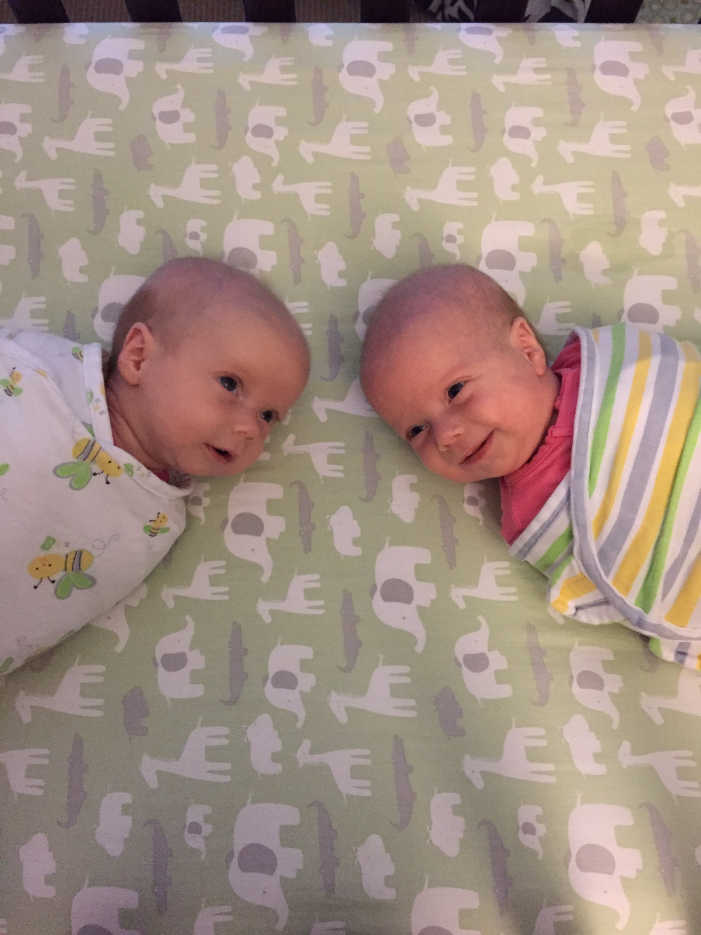
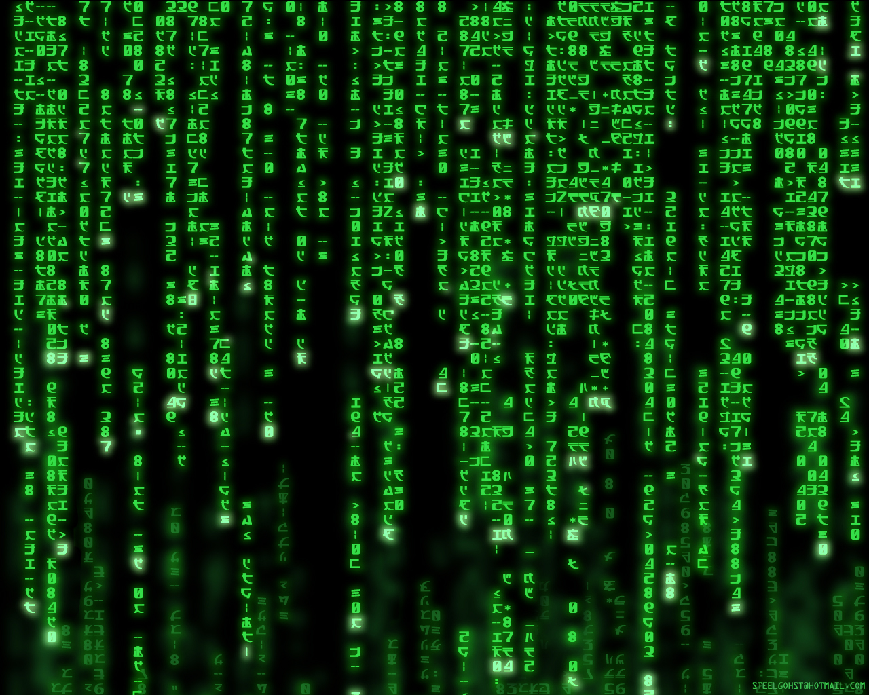
BTW, Why Is Machine Learning Hard?
Your ML Algorithm Sees
A Bunch of Bits
You See

Slide 11
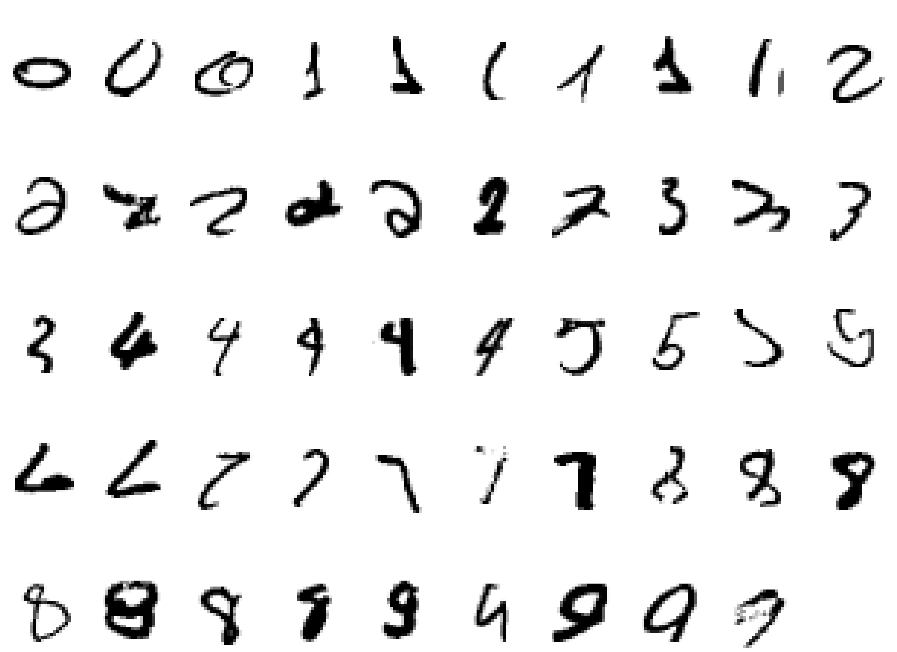
Why Machine Learning Is Hard, Redux What is a “2”?

Slide 12
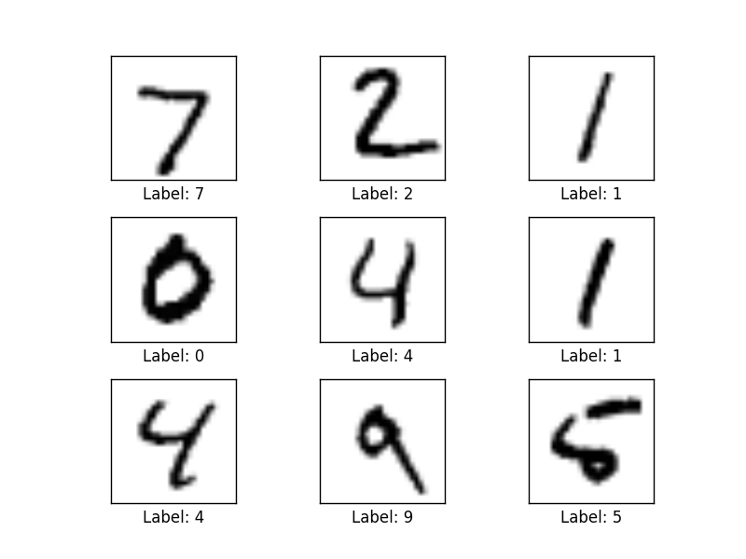
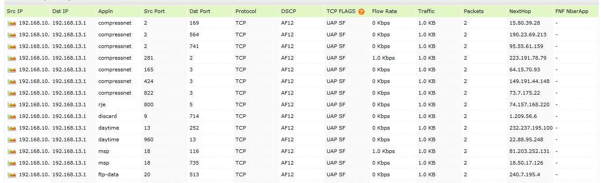
BTW, How Hard Is It These Days To Write Code That Recognizes Handwritten Digits?
MNIST: 28x28 Grayscale Handwritten Digit Dataset
Training set: 55000 images
Test set: 10000 images
Validation set: 5000 images
Features here are pixels (28x28 = 784)
Can We Analyze Network Flow Data And Other KPIs In A Similar Fashion?
Features here are
various counters and
other KPIs

Slide 13
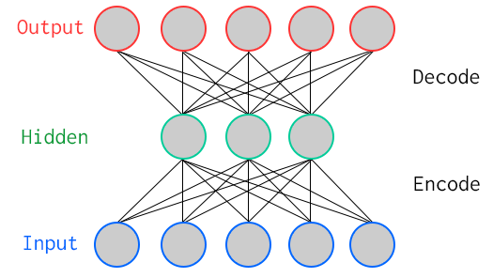
One Way To Learn To Recognize MNIST: Use An Autoencoder Special Kind of Neural Network
784
Artificial Neurons
100
Artificial Neurons
784
Key Characteristic: Hidden layer has fewer units than input/output → Compression
Goal: Minimize reconstruction (decode) error
How to define error (loss, cost)?
Binary classification: Threshold reconstruction error → normal/abnormal
Unsupervised learning

Slide 14
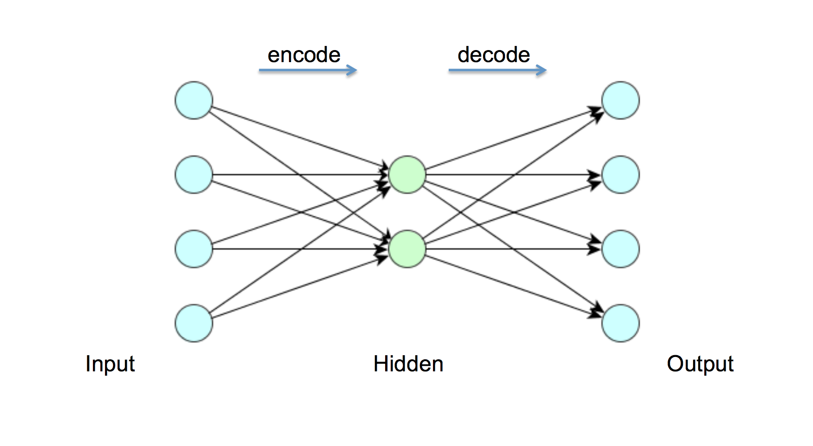
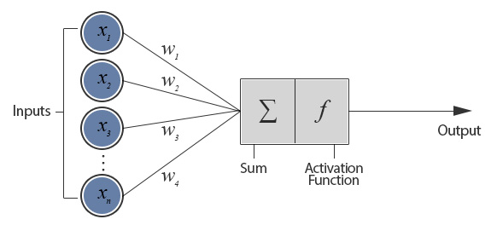
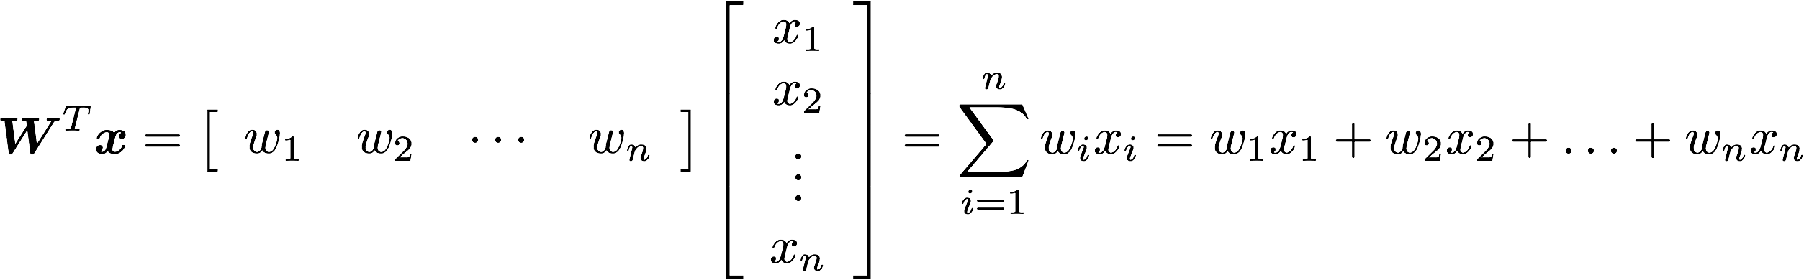
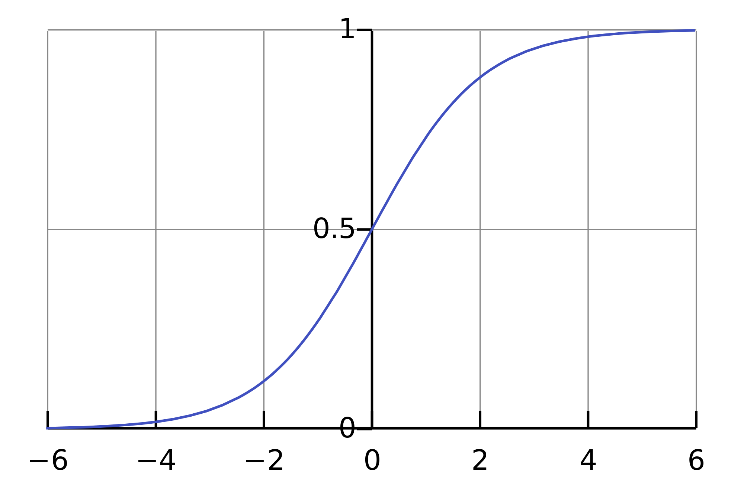
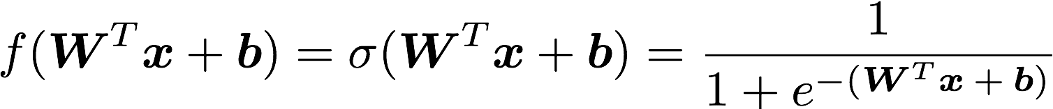
But First: What Does A Single Neuron Do?
Dot Product
784
100
784
BTW, how many parameters?
784x100 + 100x784 = 156800

Slide 15
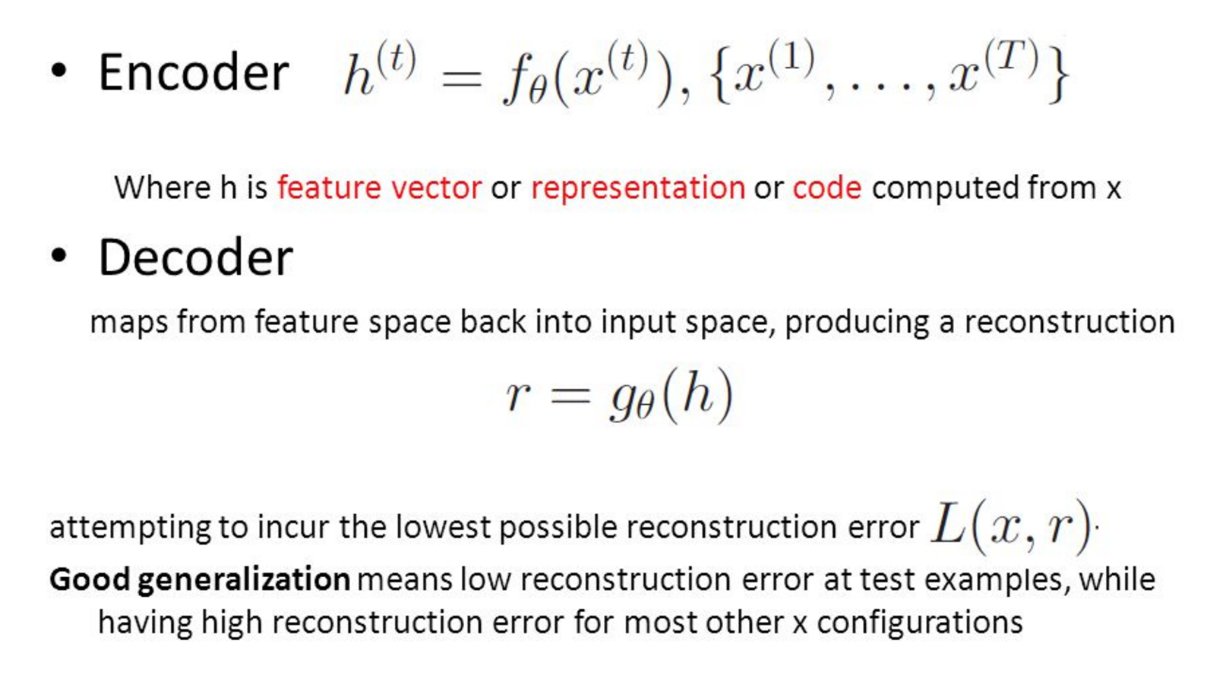
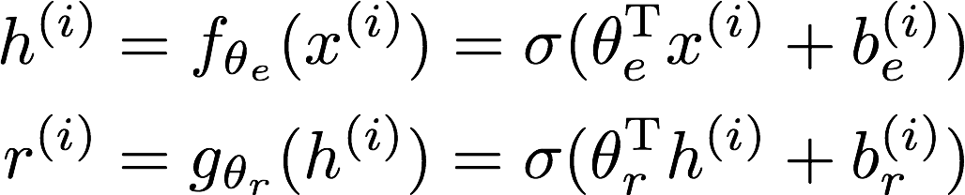
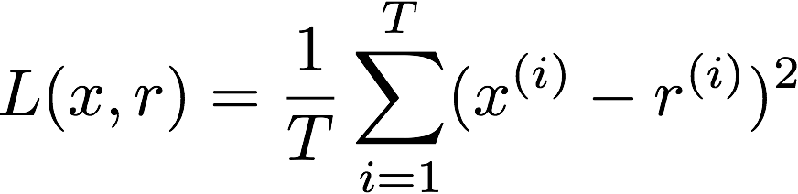
All Cool, But How Does The Autoencoder Actually Work?

Slide 16
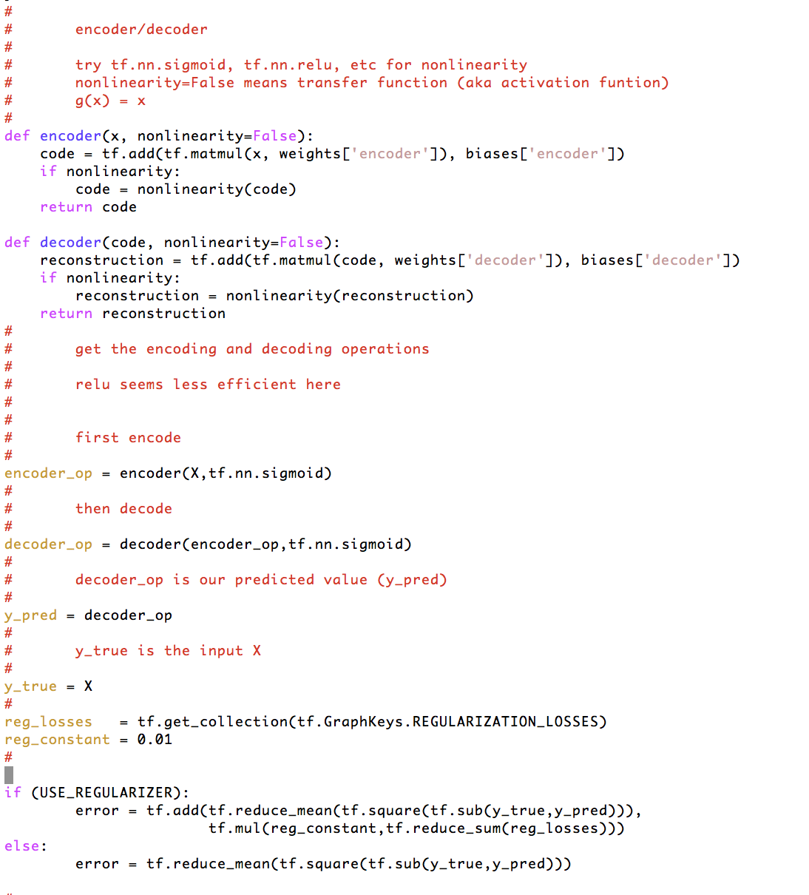

How Hard To Code This Up In Tensorflow?
https://github.com/davidmeyer/ml/blob/master/tensorflow/autoencoder.{py,ipynb}

Slide 17
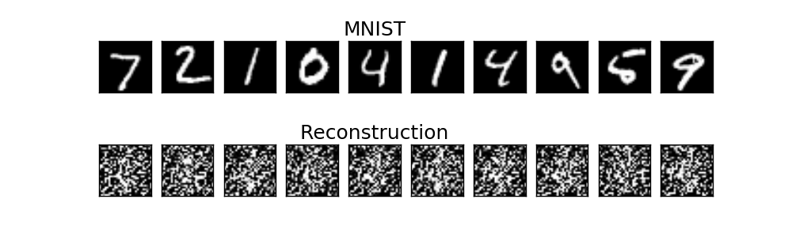
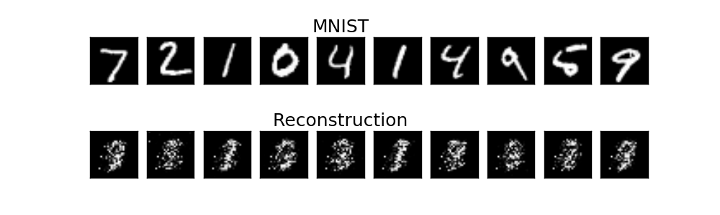
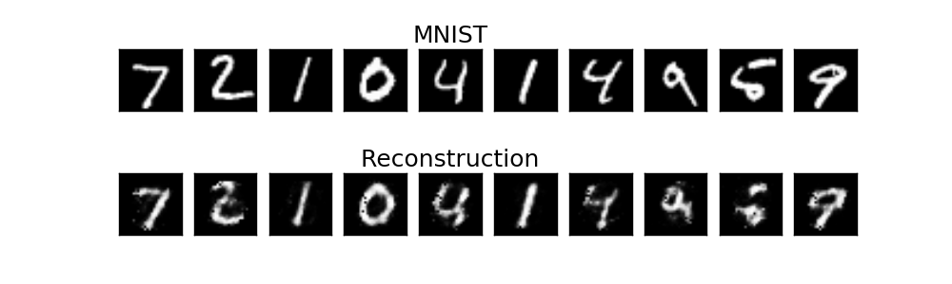
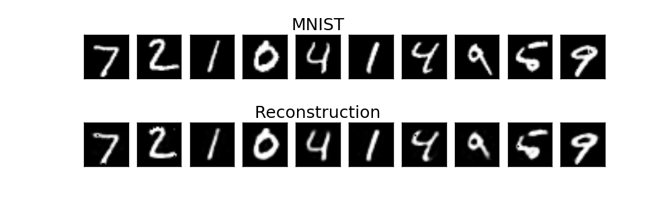
Autoencoder Output
1 example
10 examples
100 examples
1000 examples
After training, the AE gets low reconstruction error on digits from MNIST and high reconstruction error on everything else: It has learned to recognize MNIST

Slide 18
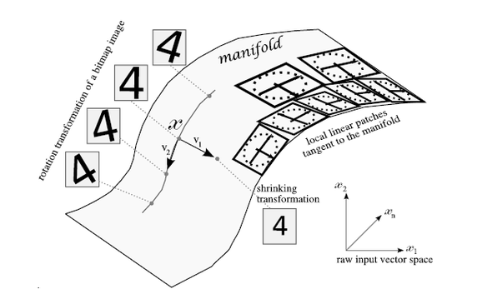
What Is Really Going On Here? (Manifold Hypothesis)
X is a high dimensional vector (28² = 784)
Data concentrated around a lower dimensional manifold
Hope to find representation R of that manifold
Graphic courtesy http://www.deeplearningbook.org

Slide 19
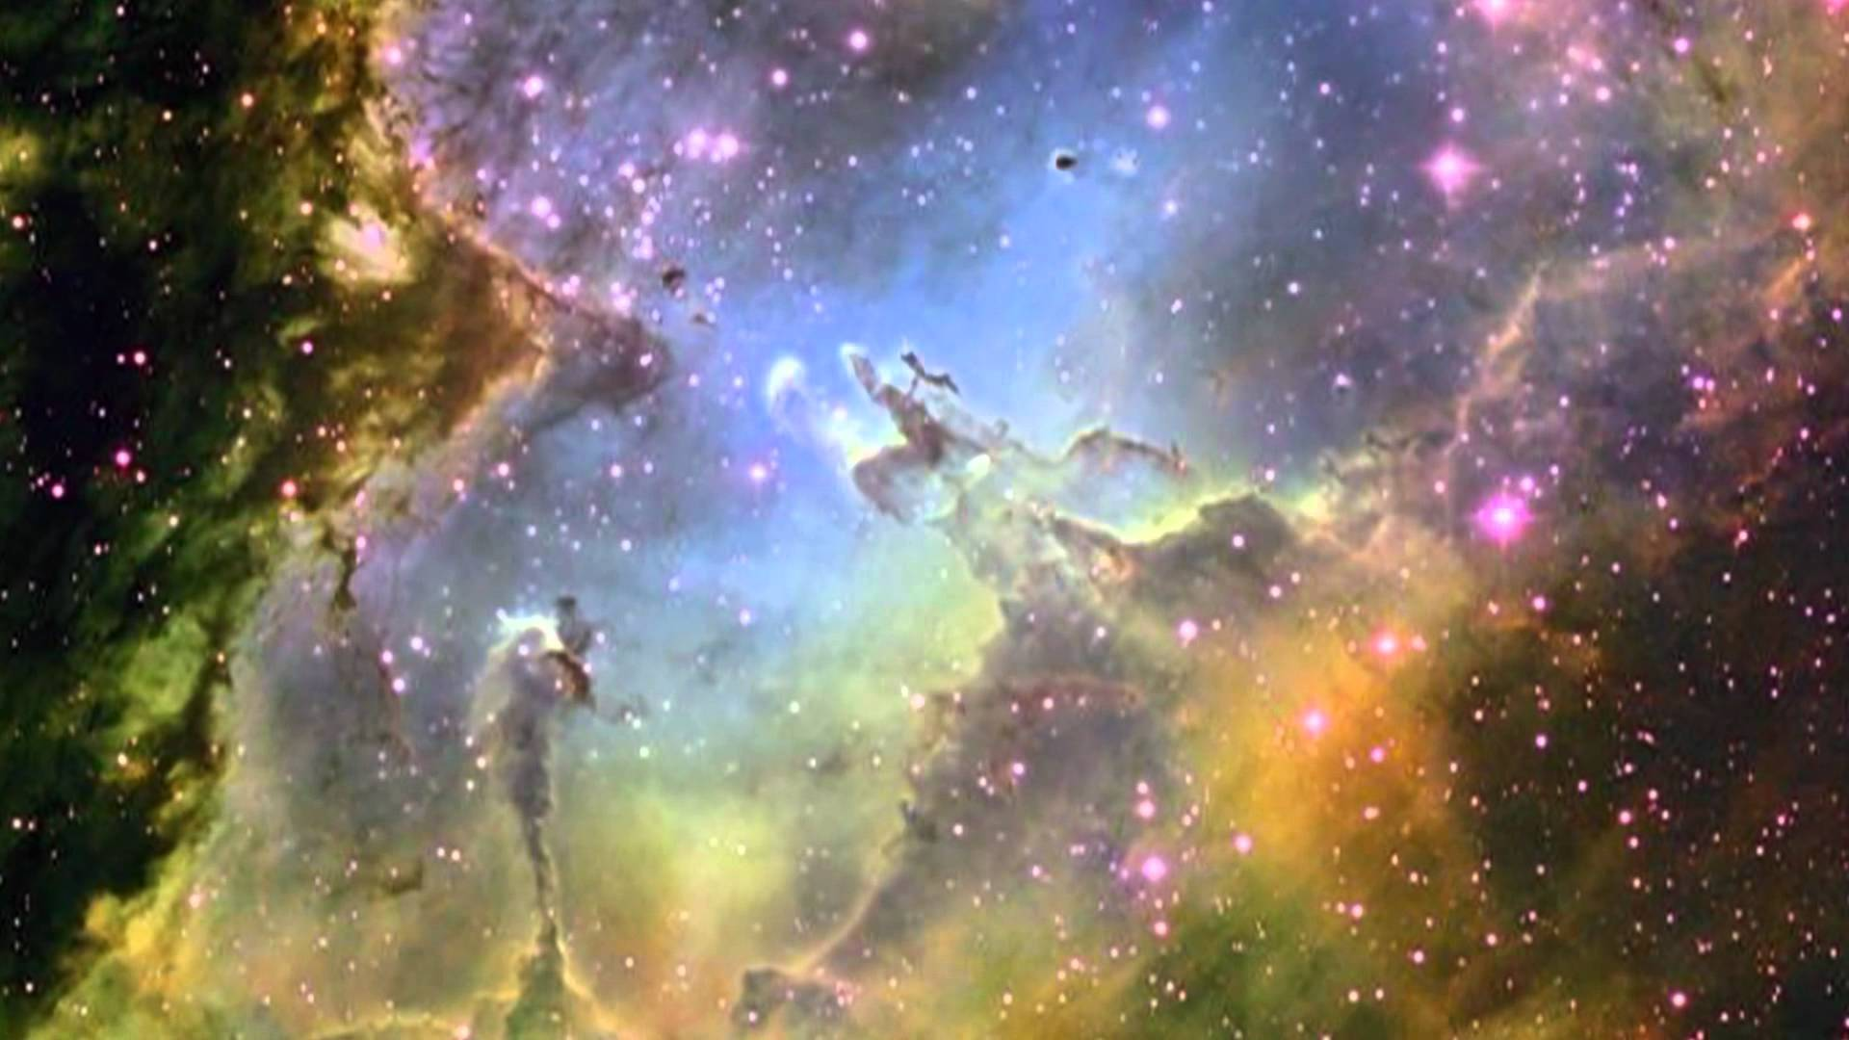
Many Beautiful Mysteries Remain
Back-propagation
Gradient-based optimization with gradients computed by back-prop
Why is such a simple algorithm so powerful?
Optimization an active area of research
Many new techniques , e.g., Layer Normalization
https://arxiv.org/pdf/1607.06450v1.pdf
Neural Nets
What are the units (artificial neurons) actually doing?
https://arxiv.org/pdf/1509.06321.pdf
Adversarial Images
Generative Adversarial Nets (GANs)
https://arxiv.org/abs/1412.6572
Why does deep and cheap learning work so well?
Physics perspective
http://arxiv.org/pdf/1608.08225v1.pdf
…
BTW, how many 28x28 grayscale images are there?
Say there are 8 bits of grayscale → 256⁷⁸⁴ possible images
How can such a simple autoencoder recognize them?

Slide 20
Agenda
What Is Machine Learning?
Why All The (Machine Learning) Excitement?
Combining SDN and Machine Learning
What’s On the Horizon?
Technical explanations/code
https://github.com/davidmeyer/ml
http://www.1-4-5.net/~dmm/ml

Slide 21
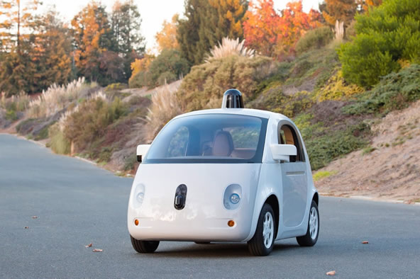
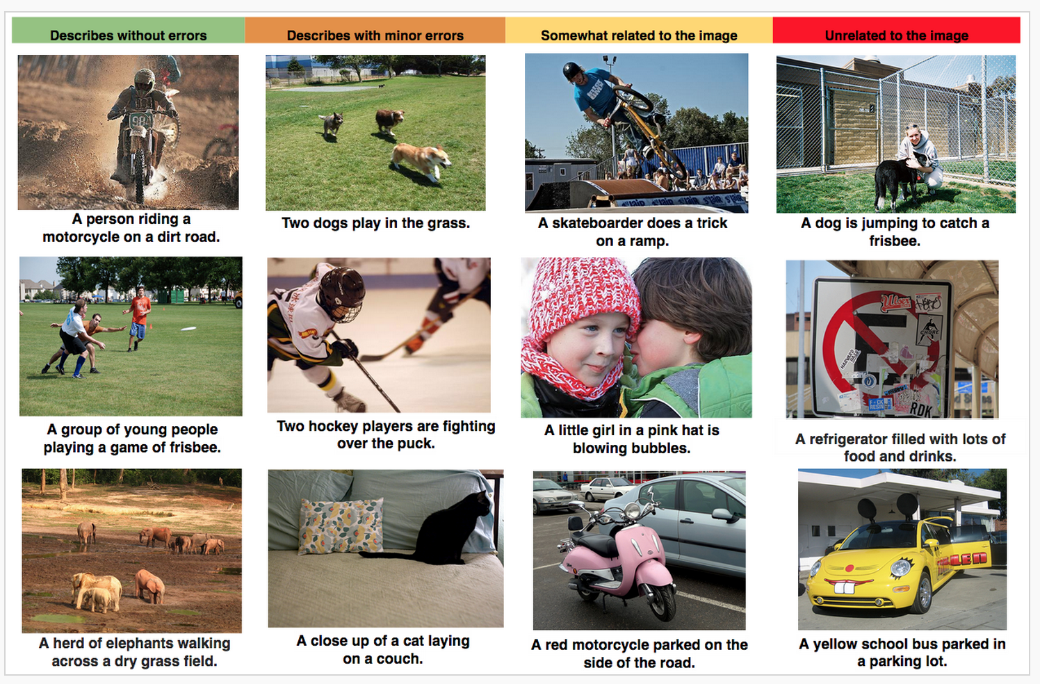

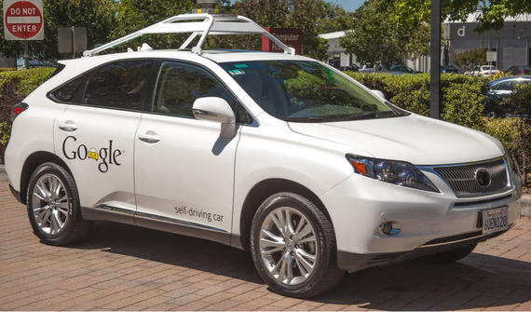
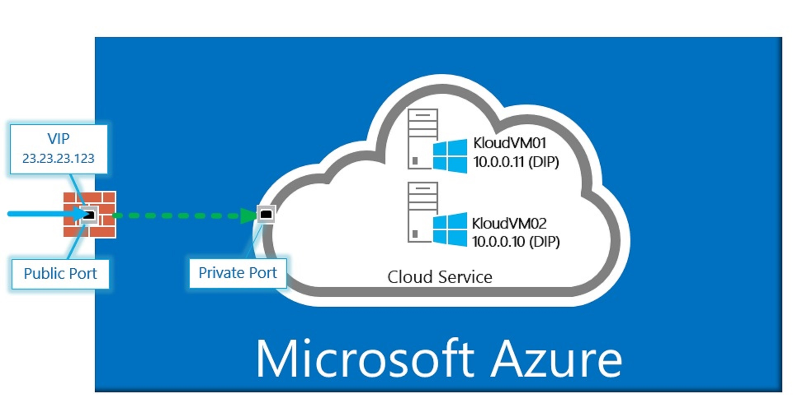
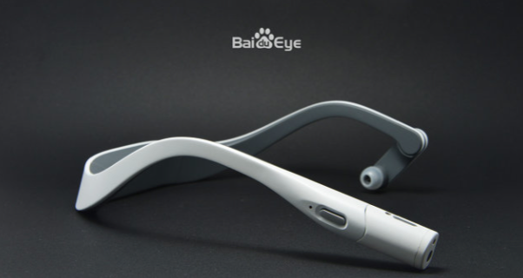

Why All The ML Excitement? ML Applications You Likely Interact With Everyday
Why this is relevant: Compute, Storage, Networking, Security and Energy (CSNSE)
use cases will all use similar technology (deep nets, …)

Slide 22
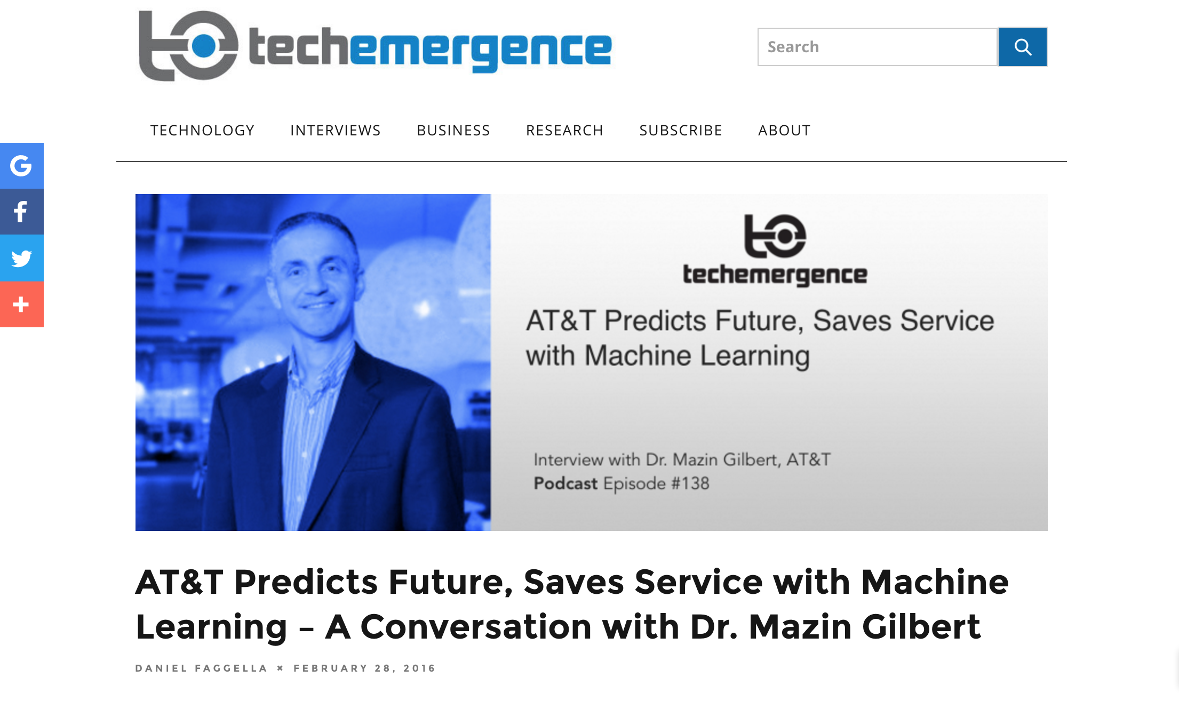
While ML For Networking Is Still In Its Infancy…
Machine learning is revolutionizing the world as we know it, both in and out of the
digital realms, and is predicted to expand to a $2 trillion market by 2025.

Slide 23

5G Networks

Slide 24
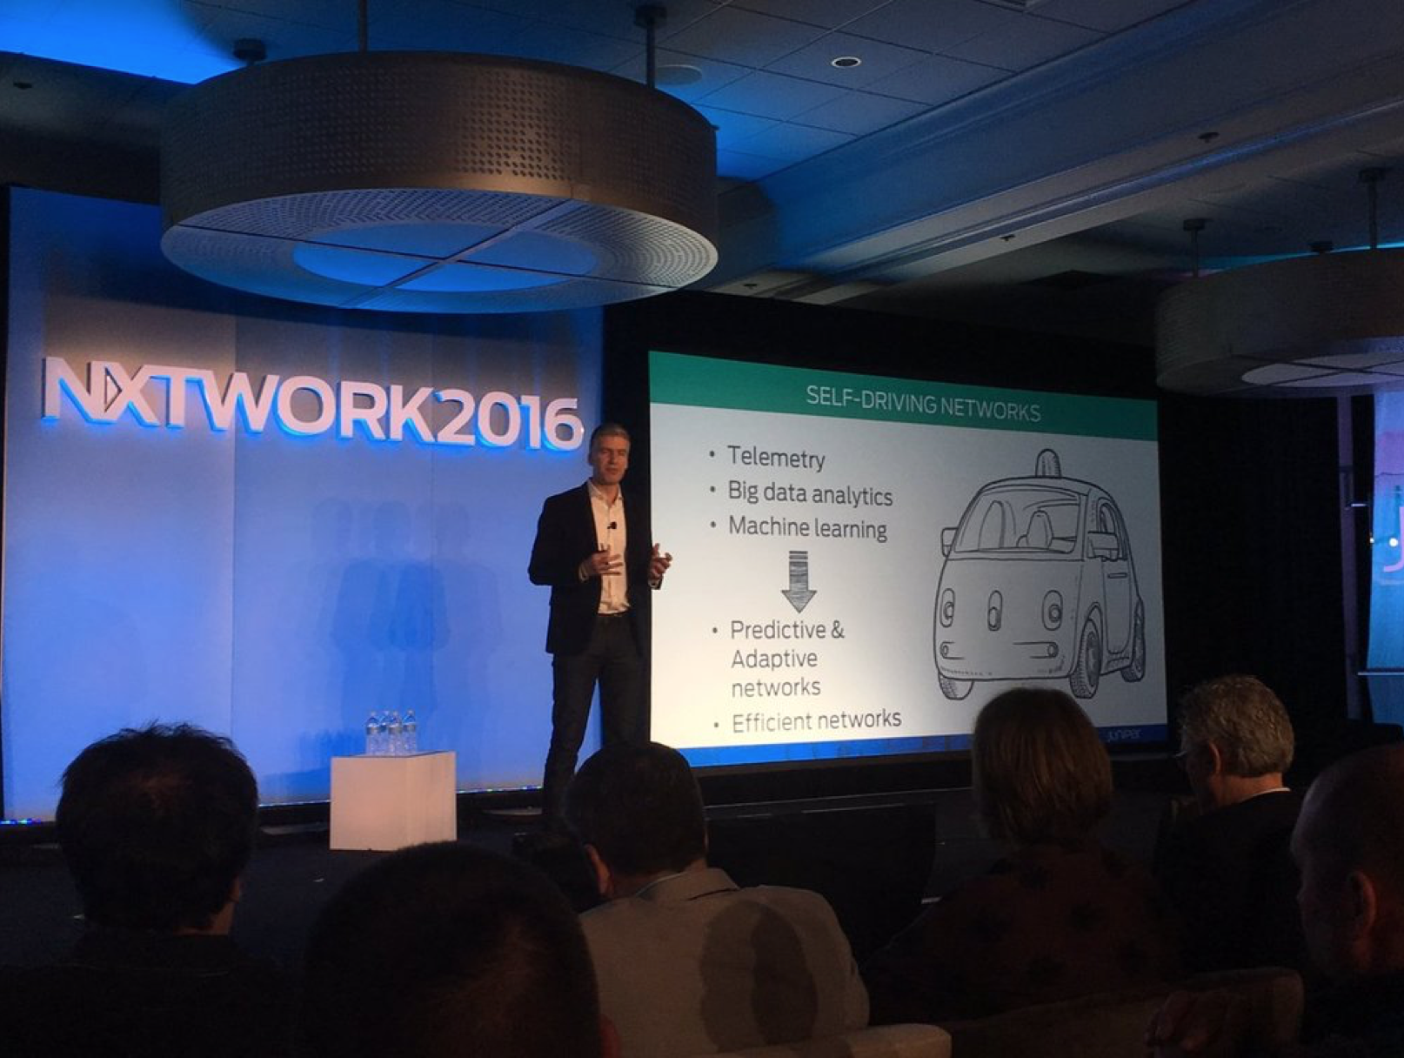
Vendors Joining The Game As Well

Slide 25
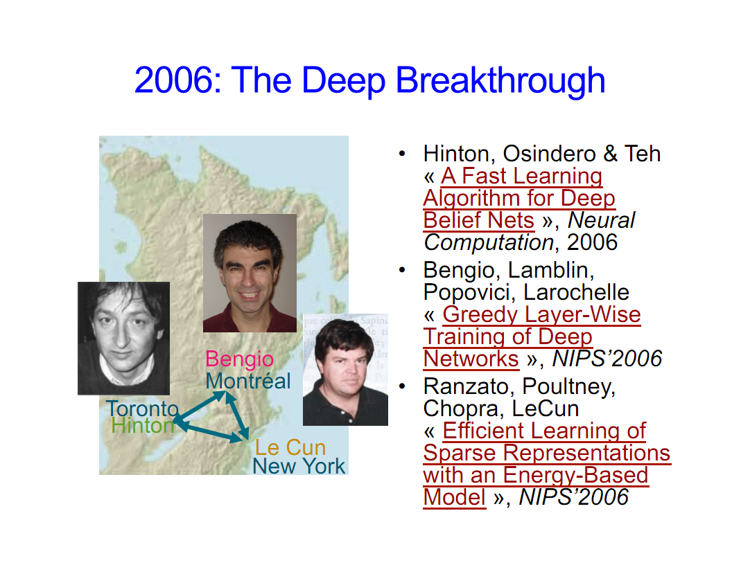
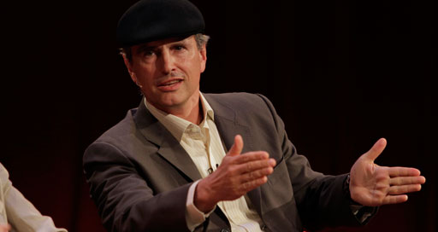
Why is this all happening now?
Before 2006 people thought deep neural networks couldn’t be trained
So why now?
Theoretical breakthroughs in 2006
Learned how to train deep neural networks
Technically: RBMs, Stacked autoencoders, sparse coding
Nice overview of LBH DL journey: http://chronicle.com/article/The-Believers/190147/
Compute
CPUs were 2^20s of times too slow
Parallel processing/algorithms
GPUs + OpenCL/CUDA
FPGAs, custom hardware
Datasets
Massive data sets: Google, FB, Baidu, …
Standardized data sets
Alternate view of history?
LBH Nature DL review: http://www.nature.com/nature/journal/v521/n7553/full/nature14539.html
Jürgen Schmidhuber’s critique : http://people.idsia.ch/~juergen/deep-learning-conspiracy.html
LBH rebuttal: http://recode.net/2015/07/15/ai-conspiracy-the-scientists-behind-deep-learning/
Image courtesy Yoshua Bengio

Slide 26
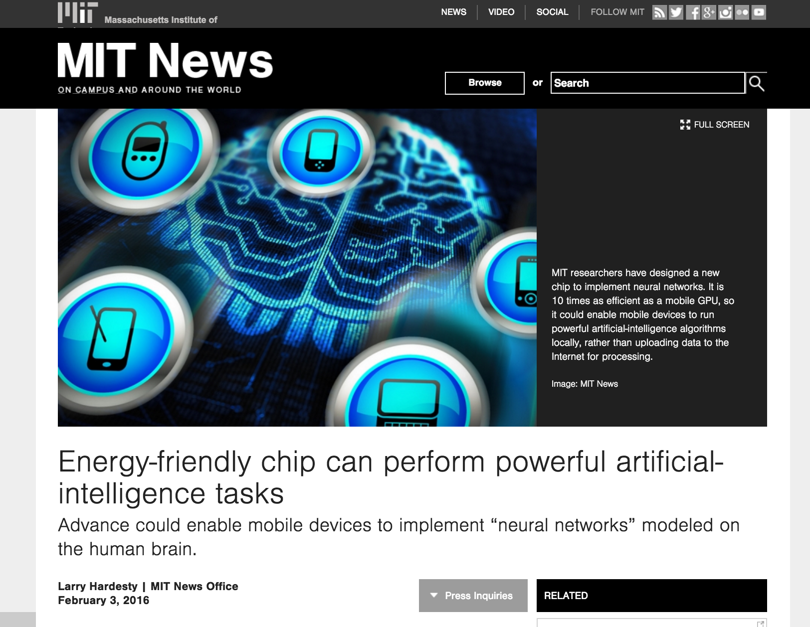
BTW, What Kinds of Custom H/W?

Slide 27
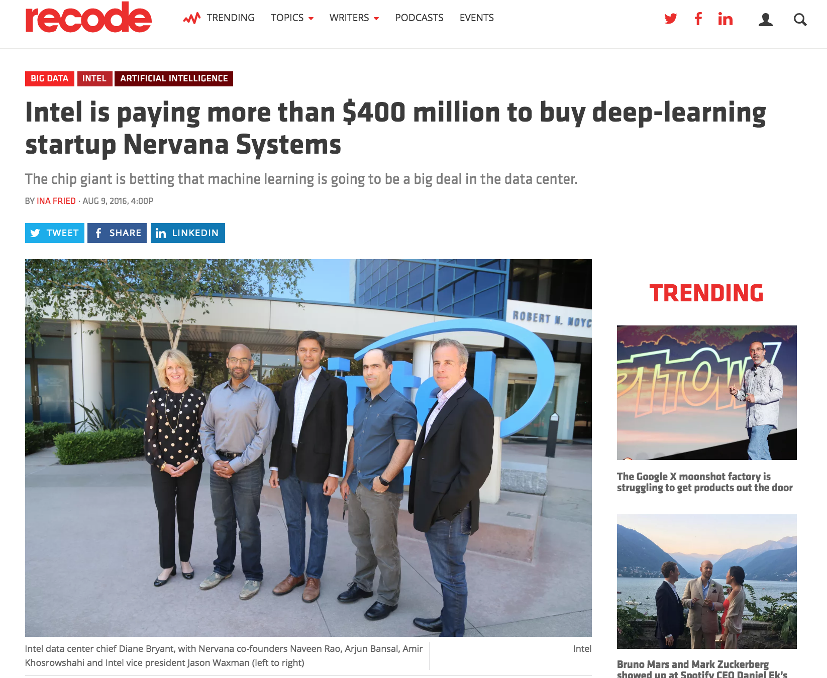
What Kinds of Custom H/W, cont

Slide 28
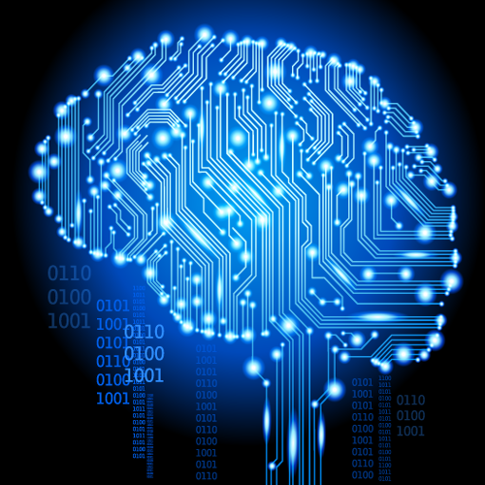
So What Kinds of Network Oriented Use Cases Have We Been Working On?
Security/Anomaly Detection
Site Reliability Engineering
NFV orchestration and optimization
New automation tools for DevOps
Predicting and remediating problems mobile networks
Network control plane optimization
Network Gamification
...
Importantly, we can use deep
neural networks to capture
intuition from experts in these
problem domains

Slide 29
Agenda
What Is Machine Learning?
Why All The (Machine Learning) Excitement?
Combining SDN and Machine Learning
What’s On the Horizon?
Technical explanations/code
https://github.com/davidmeyer/ml
http://www.1-4-5.net/~dmm/ml

Slide 30
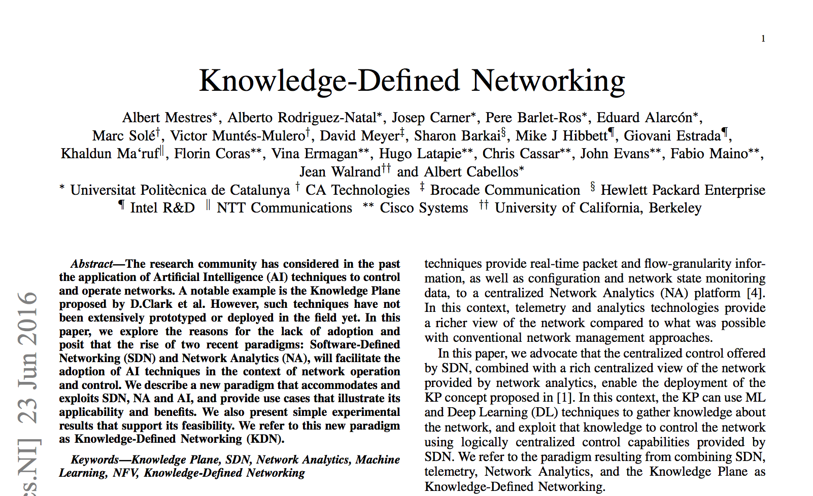
Combining SDN and Machine Learning
https://arxiv.org/abs/1606.06222

Slide 31
Knowledge-Defined Networking Basic Control Loop
Note: There is hard coded
logic in this picture
Graphic courtesy Albert Cabellos

Slide 32
Kinds of Applications We Are Doing?
Recommendation
Optimization
Hidden Information
Complex systems
Estimation
Performance/Cost
Validation
Performance/Cost
Knowledge discovery
Graphic courtesy Albert Cabellos

Slide 33
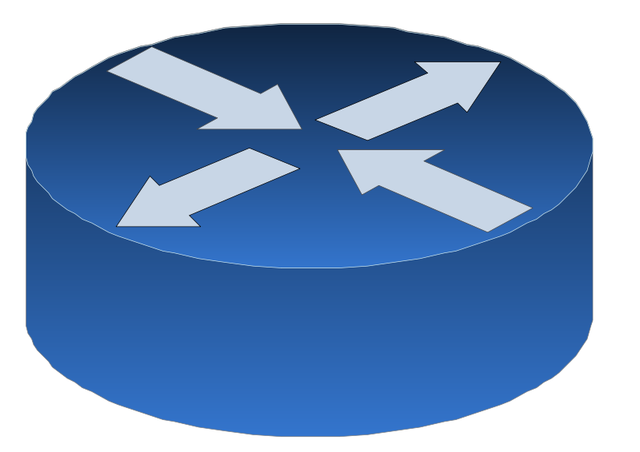

Example: Can We Learn Optimal Paths In An Overlay Network?
B
A
Unknown undelay
network
D
C
Which egress/ingress links should overlay routers use? E.g. A or B and C or D?
Underlay is assumed that has an arbitrary constant routing
Underlay is assumed as hidden and not under our control
Overlay protocol is assumed to be able to choose egress and ingress links, we refer to this as routing policy
Goal: Achieve overall minimum latency between overlay nodes

Slide 34


Optimizing Paths, cont
What we want to predict
For a given traffic matrix, predict the ingress/egress link configuration that minimizes delay between ingress and egress
Training Set
{(x^{(i)},y^{(i)})}, i = 1,…,N
x^{(i)} = (src^{(i)}, dst^{(i)}, bandwitdth^{(i)})
y^{(i)} = delay^{(i)}
Loss function: sum of delays (minimize this)
Learn f: X → Y
y^{(i)} = f(x^{(i)})
For a new x predict y
Models
Neural Network
SVM
Polynomial Regession
SDN Controller
Model
Optimize
Train
http://knowledgedefinednetworking.org/

Slide 35
Simulation: MSE vs. Training Set Size (Scale-free, Poisson traffic, 9 Active stations)

Slide 36
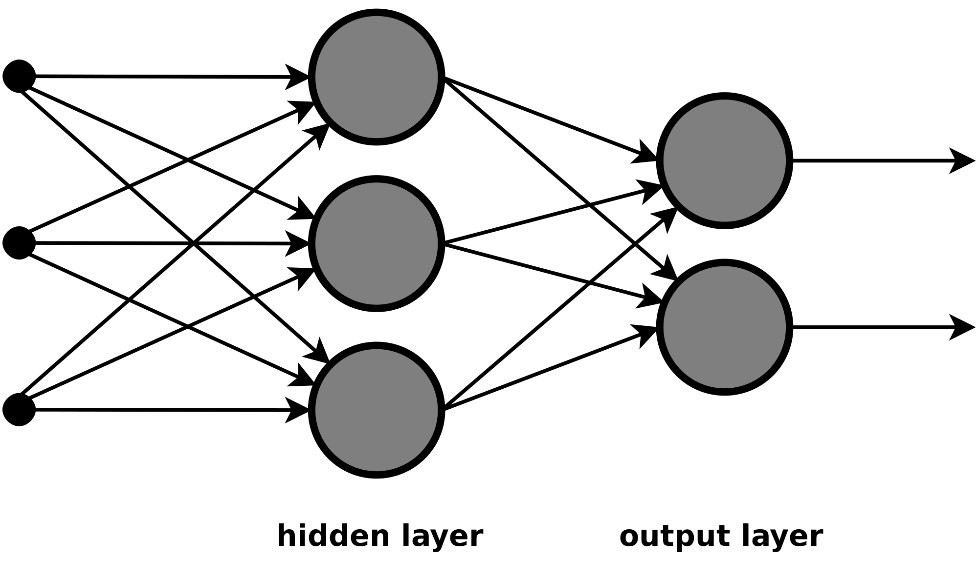
System View
Training Set:
Routing policy
Traffic Load
Performance metric: delay
Machine Learning
Faster, more accurate than network modeling/simulation.
Can be used for estimation, optimization and validation
B
A
D
Computational
Model
C
Graphic courtesy Albert Cabellos

Slide 37
Agenda
What Is Machine Learning?
Why All The (Machine Learning) Excitement?
Combining SDN and Machine Learning
What’s On the Horizon?
Technical explanations/code
https://github.com/davidmeyer/ml
http://www.1-4-5.net/~dmm/ml

Slide 38
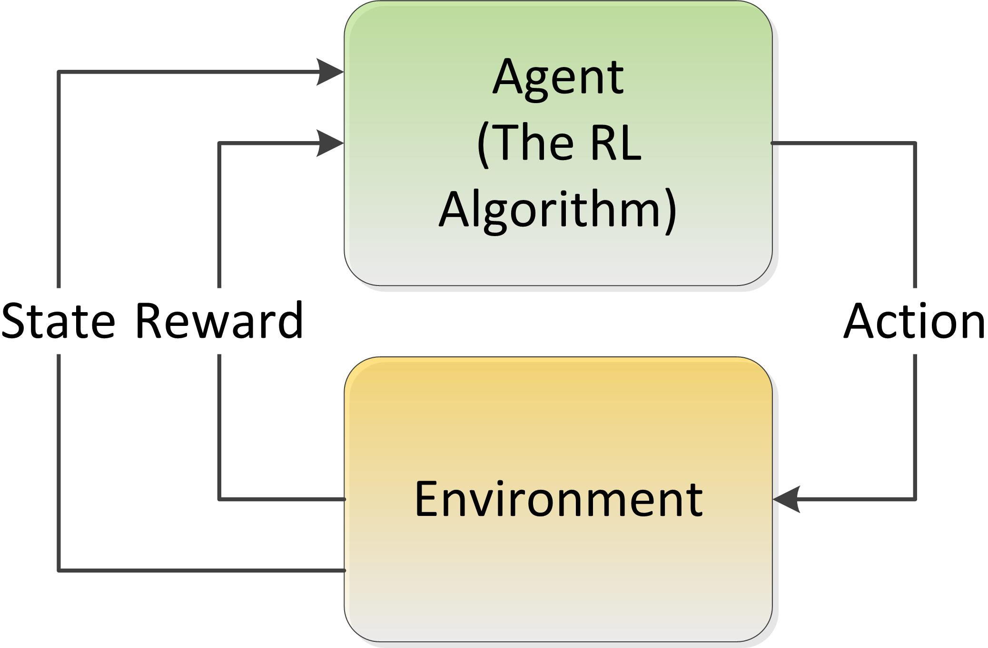
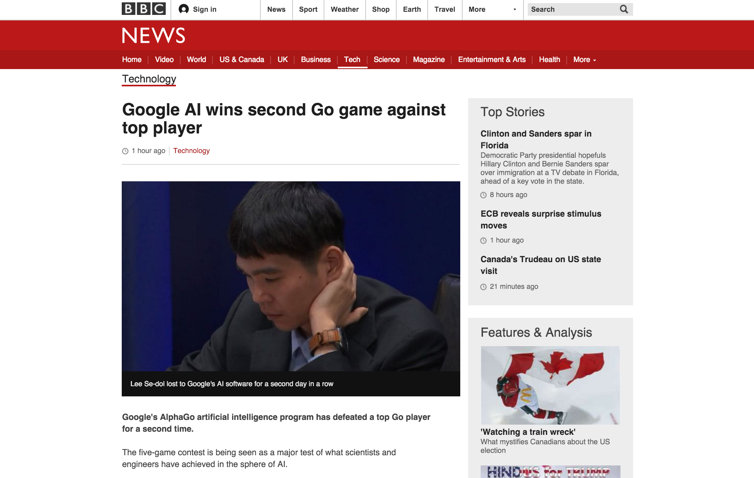
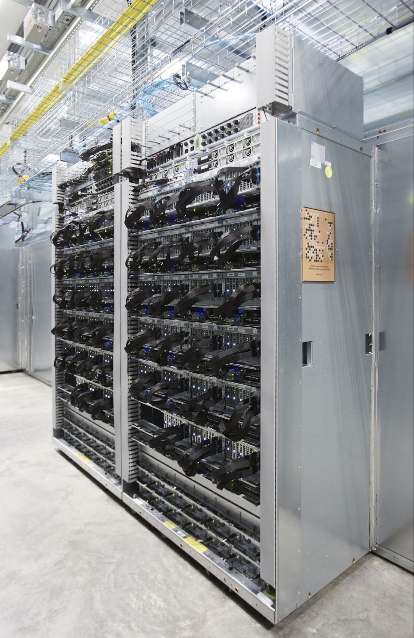
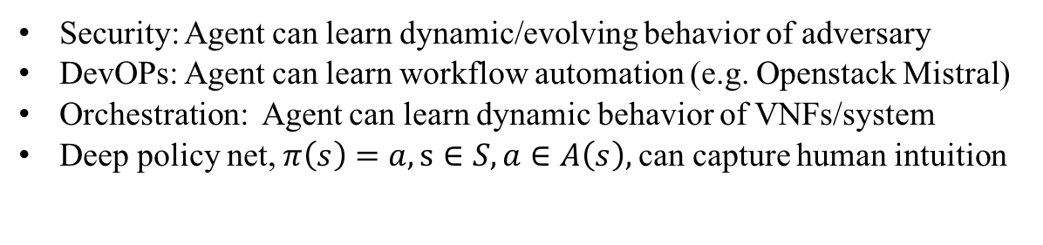
But There’s More: We Can Learn Control Reinforcement Learning Meets Monte Carlo Tree Search and Deep Learning
Hard coded control logic
Security: Agent can learn dynamic/evolving behavior of adversary
DevOPs: Agent can learn workflow automation (e.g. Openstack Mistral)
Orchestration: Agent can learn dynamic behavior of VNFs/system
Deep policy net, $π\left(s\right)=a, s∈S, a∈A\left(s\right),$can capture human intuition
http://www.nature.com/nature/journal/v529/n7587/full/nature16961.html

Slide 39
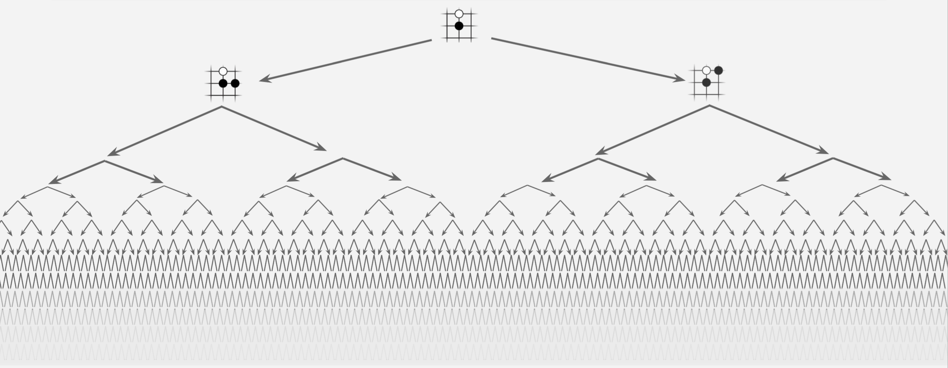
BTW, Why Is Go So Hard?
Game Tree Complexity = b^{d}
Brute Force Search Intractable
Search space is huge (10^721)
Difficult to evaluate who is winning
Can we characterize network state and action spaces?
And why is this important?

Slide 40
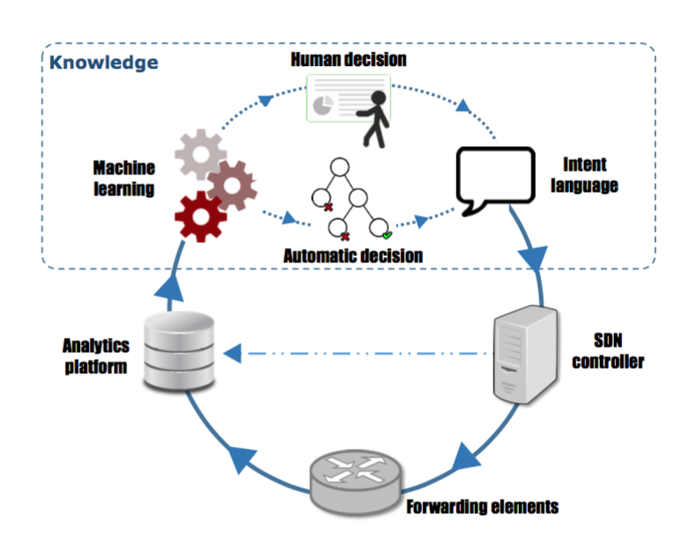
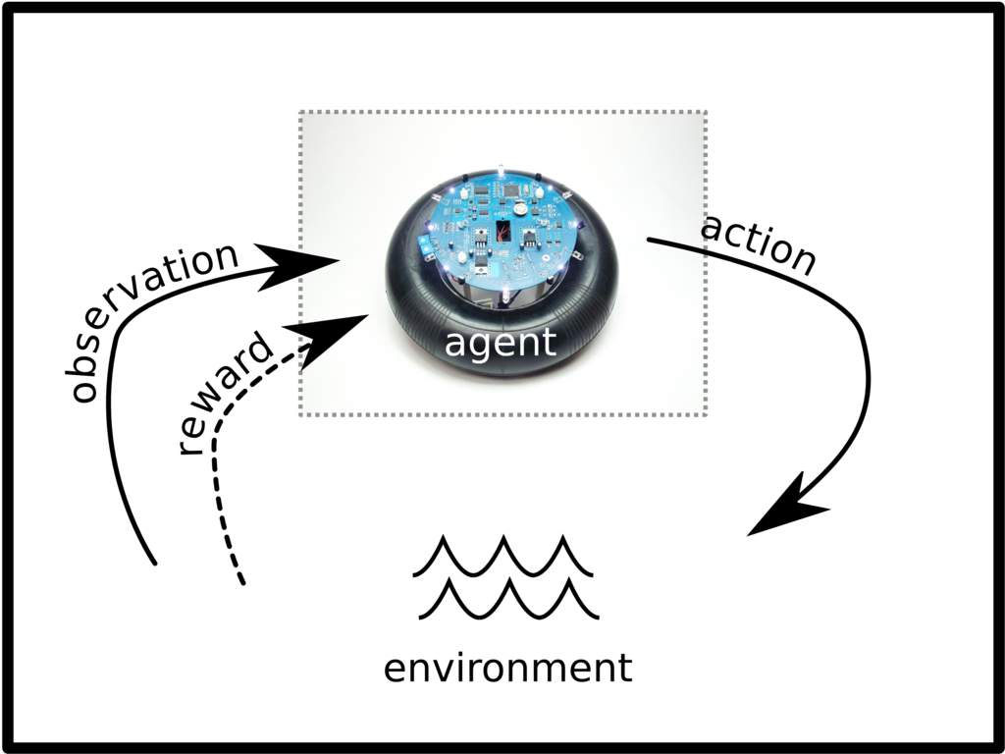
Static vs. Reinforcement Learning Architectures
Today’s Static ML Architectures
ML doesn’t have “agency”
Hard-coded or open loop control
Doesn’t learn control
Assumes stationary DGD
Largely off-line
Reinforcement Learning Architecture
Agent architecture
Agent learns control/action selection
Adapts to evolving environment
Non-stationary distributions
Network gamification

Slide 41
Agenda
What Is Machine Learning?
Why All The (Machine Learning) Excitement?
Combining SDN and Machine Learning
What’s On the Horizon?
Technical explanations/code
https://github.com/davidmeyer/ml
http://www.1-4-5.net/~dmm/ml

Slide 42
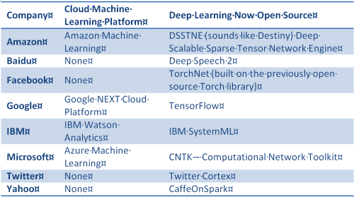
Summary
Lots of Network Data
Standardized and labeled datasets still scarce
Lots of open source ML frameworks and examples
Tensorflow (tensorflow.org)
Torch (torch.ch)
Scikit-learn (scikit-learn.org)
…
Still requires skill/experience to
Build DNN architectures
Find ”good” settings for hyper-parameters
Prevent overfitting
…
You will be seeing Machine Learning in all facets of Networking
And everything else for that matter
All of that said, the time to get your feet wet is now!

Slide 43
Q&A
Thank you
(have more questions/comments? dmm@1-4-5.net)

